Slide 1
Information and Network Security
Information Security Governance and Risk Management

Slide 2
Agenda
Basic Concepts
Types of Controls
Risk Analysis and Management
Quantified Risk Analysis
Risk Management Strategies
Other Functions of Domain

Slide 3
Basic Concepts of Information Security
Asset
Vulnerability
Threat
Threat Agent
Exposure Factor/Impact
Risk
Control/Counter Measure/Safeguard

Slide 4
Asset
Anything that is of value for an organization
E.g. Information, Software, Hardware, Human
Vulnerability
A weakness /defect in a system or absence of a safeguard
Threat
A threat is a potential danger for an Asset
Its an event that if happen will adversely affect an Asset

Slide 5
Threat Agent
The entity which causes threat to happen is threat agent.
E.g. an intruder in a system, Malware, Nature
Exposure Factor/Impact
Percentage of asset loss caused by threat
Risk
Likelihood of threat agent exploiting a vulnerability and its impact on asset
Risk ties the likelihood, vulnerability and threat to the resulting business impact.

Slide 6
Security Controls
Control/Safeguard/Counter Measure
A control is implemented to mitigate the Risk.
E.g. Fire Extinguisher, Password Policy, Firewall
Types of Controls
Physical Controls
Guards, Identity Badges, Smoke Detector etc
Logical Controls
Administrative Controls
Policies and Procedures
Technical Controls
Firewall, IDS, Antivirus, Port Binding etc.

Slide 7
Administrative Controls
Policy
A policy is a general statement produced by senior management that dictates what role security will play in organization or what is acceptable and not acceptable generally.
Policies are usually broad documents that require procedures to implement them.
Standards
A standard refer to mandatory activities, actions or rules.
E.g. ISO 9001, ISO 27001 etc.

Slide 8
Policies, Procedures, Baselines, Guidelines
Baselines
The term baseline refers to a point in time that is used as a comparison for future changes.
Baselines are also used to define the minimum level of protection required.
In security, specific baselines can be defined per system type, which indicates the necessary settings and the level of protection being provided

Slide 9
Guidelines
Guidelines are recommended actions and operational guides.
Industry best practices falls in this category

Slide 10
Types of Controls (Functionalities)
Deterrent
Preventive
Corrective
Recovery
Detective
Compensating

Slide 11
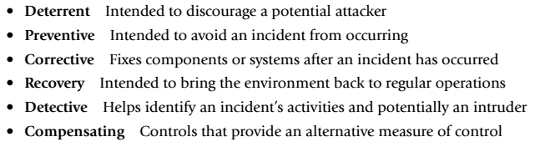
Control Functionalities
Six different control functionalities are as follows:

Slide 12
Control Functionalities
Preventive: administrative
Policies and procedures
Effective hiring practices
Pre-employment background checks
Controlled termination processes
Data classification and labeling
Security awareness
Preventive: Physical
Badges, swipe cards
Guards, dogs
Fences, locks, mantraps
Preventive: Technical
Passwords, biometrics, smart cards
Encryption, secure protocols, call-back systems, database views, constrained
user interfaces
Antimalware software, access control lists, firewalls, intrusion prevention system

Slide 13
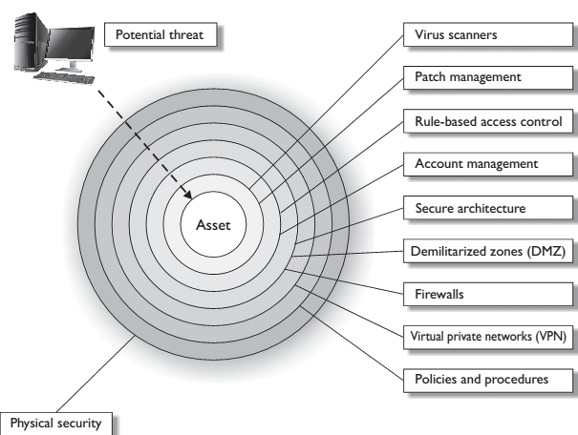
Defense in Depth
Controls are implemented in layers to ensure defense in depth.
Implementation of
multiple controls
so that the successful
breach is difficult
to achieve for attacker

Slide 14
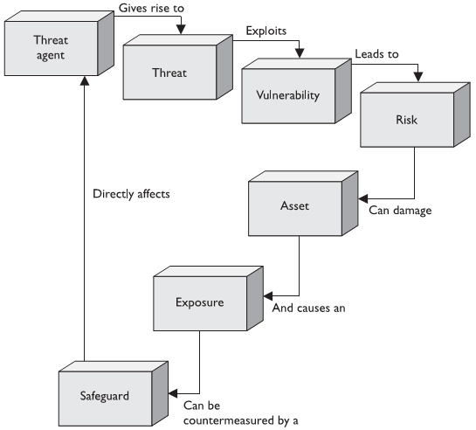
Relationship between discussed concepts

Slide 15
Risk Analysis and Management
Risk
Risk is the likelihood of occurrence of a threat and the damage it causes to the assets.
Risk = Likelihood of occurrence of a threat x Impact

Slide 16
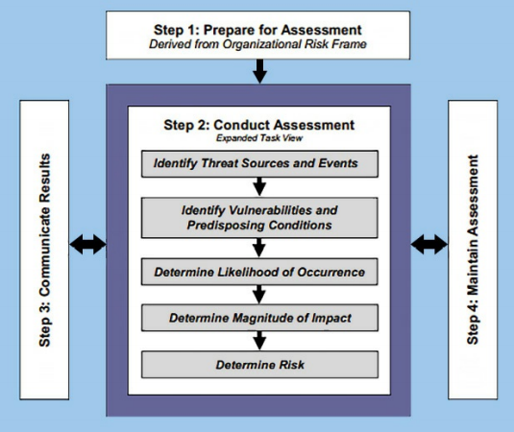
NIST Risk Assessment Framework

Slide 17
Risk Analysis
Before Managing Risk, you have to analyze what risks are prevalent to your organization.
A Risk analysis consist of four phases:
Asset Identification
Vulnerabilities and Threats to Assets
Quantified Likelihood of threat and its impact on asset
Cost of Countermeasures
Risk Analysis provides a cost/benefit comparison of Risk and cost of countermeasure

Slide 18
Quantified Risk Analysis
The objective is to assign dollar value to risk.
SLE
defined as the difference between the original value and the remaining value of an asset after a single impact of a threat.
SLE = asset value (in $) × exposure factor as a %)
ARO
Measures the likelihood of threat
an estimate of how often a threat will be successful in exploiting a vulnerability over the period of a year
ALE
ARO * SLE
Once we have a value of Risk, we can decide how we want to manage risk.

Slide 19
Cost benefit analysis (CBA) Also known as an economic feasibility study, the formal assessment and presentation of the economic expenditures needed for a particular security control, contrasted with its projected value to the organization.
single loss expectancy (SLE) In a cost-benefit analysis, the calculated value associated with the most likely loss from an attack. The SLE is the product of the asset’s value and the exposure factor.
exposure factor (EF) In a cost-benefit analysis, the expected percentage of loss that would occur from a particular attack.
annualized rate of occurrence (ARO) In a cost-benefit analysis, the expected frequency of an attack, expressed on a per-year basis.
annualized loss expectancy (ALE) In a cost-benefit analysis, the product of the annualized rate of occurrence and single loss expectancy.

Slide 20
Risk Management Strategies
Risk Acceptance
Risk Avoidance
Risk Transfer
Risk Mitigation

Slide 21
Other Functions of Information Security Management
Personnel Security
Properly hiring and managing personnel
Security Awareness and Trainings
Security Monitoring and Audits

Slide 22
Information Security Auditing
Verification of implementation and Proper working of control
Auditing is performed against some benchmark i.e. Standard or Guidelines
E.g. ISO 27000 Information Security Management System requirements

Slide 23
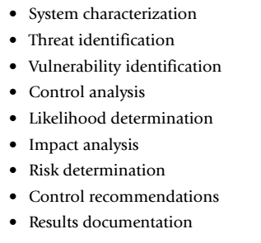

Slide 24
